Slide 1
IMPACT-A-THON
Team Name :TechZen
StudyBuddy AI
Your Ai-powered Personalized Learning Assistant

Slide 2
TABLE OF CONTENTS
01
04
Problem Statement
Major Requirements
02
05
About the Project
Our Goals
03
06
Our Solution
Our Team

Slide 3
PROBLEM STATEMENT
College students struggle with information overload and need personalized study guidance. How can AI help students organize, prioritize, and learn from vast course material

Slide 4
MAJOR REQUIREMENTS
VISUAL INSIGHTS
PERSONALIZATION
AI CAPABILITIES
AI turns complex notes into clear, simple summaries and graphs.
Learning adapts to each student’s pace and strengths.
Smart quizzes and gap analysis guide effective study.

Slide 5
ABOUT THE PROJECT
StudyBuddy AI is a personalized learning platform designed to help students overcome information overload by using artificial intelligence. It allows students to upload or paste lecture notes and instantly receive:
Concise, AI-generated summaries
Custom quiz questions to test understanding

Slide 6
NOW
OVERWHELMING AMOUNTS OF COURSE CONTENT
LENGTHY LECTURE NOTES
SCATTERED ONLINE RESOURCES.

Slide 7
FUTURE
FOCUSED LEARNING
SKILL ASSESSMENT
RESOURCE RECOMMENDATION

Slide 8
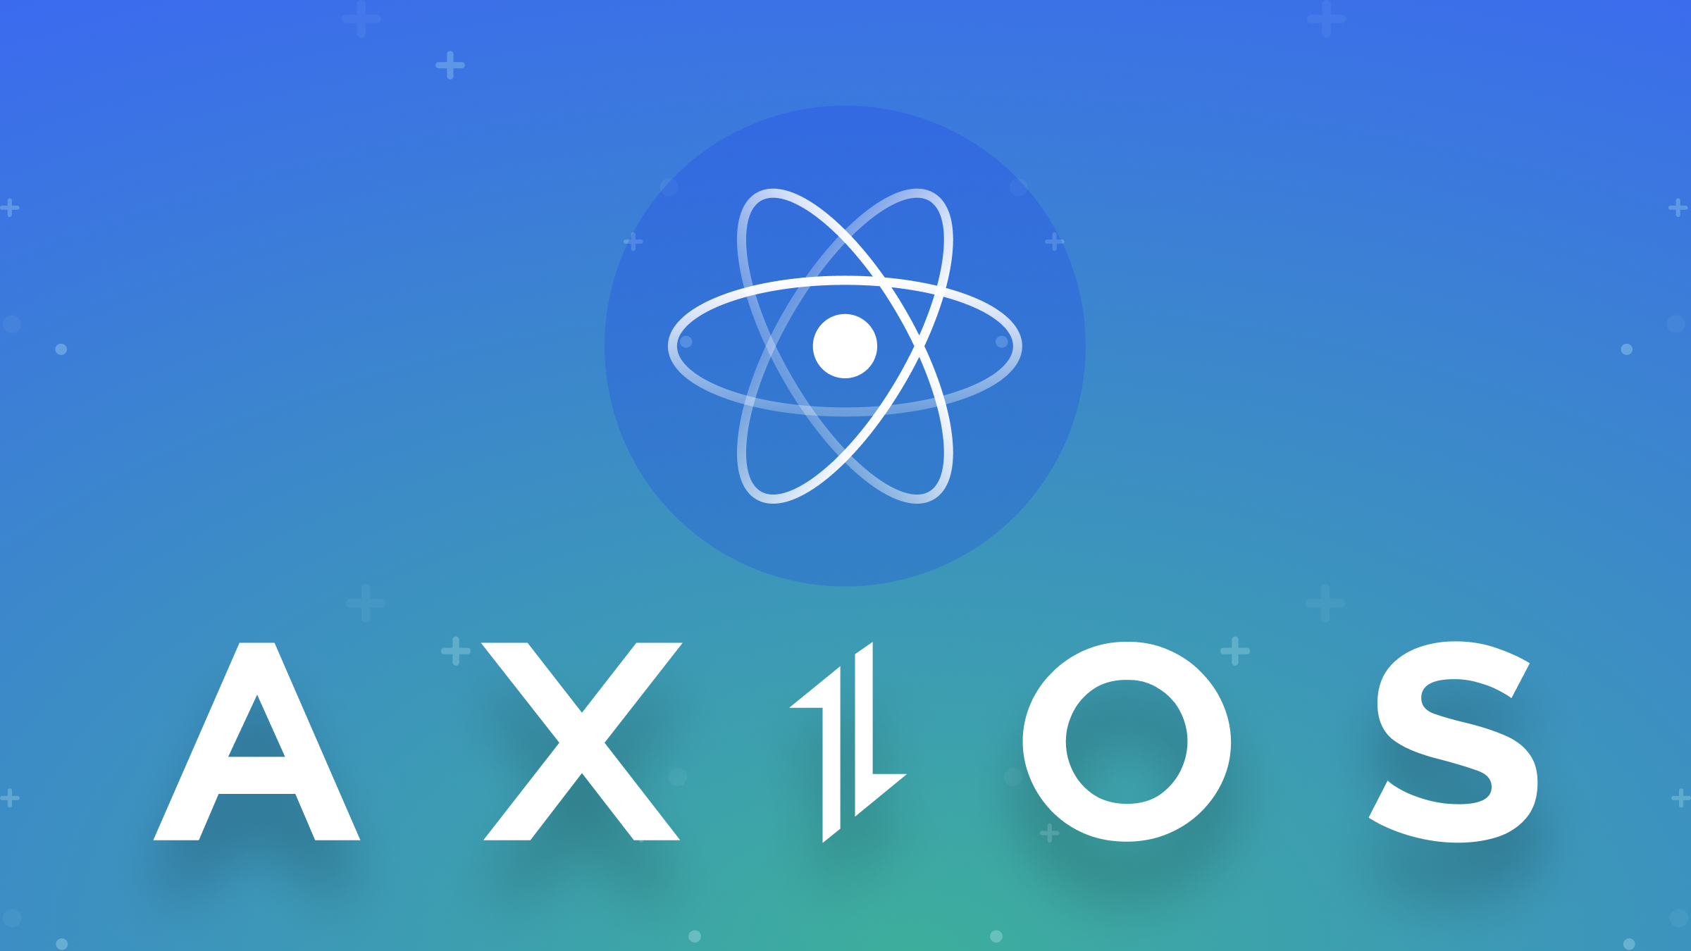


TECH STACKS USED
FRONTEND –REACT.JS
BACKEND/API HANDLING: AXIOS
AI ENGINE: OpenRouter AI
DEPLOYMENT: VERCEL / NETLIFY
Sends user input (notes) to the AI model and retrieves summaries and quizzes in real-time.
The brain of our app — turns complex lecture notes into clear, concise summaries and quiz questions personalized to the student’s material.
Hosts the web app and makes it accessible online with one-click deployment and fast load times.
Builds a fast and responsive user interface where students can paste notes and view results instantly.

Slide 9
OUR TIMELINE
PHASE 1
PHASE 3
BETA
RELEASE
FINAL
VERSION
PHASE 2
PHASE 4
Brainstorming & Planning
Frontend UI & Integration
AI Model & Backend Development
Testing & Debugging

Slide 10
OUR GOALS
SCALABILITY
PERSONALIZATION
EFFECTIVENESS
The system grows easily to support many users and courses.
Content adapts to each student’s unique learning style.
AI boosts learning by targeting weak spots with quizzes.

Slide 11
PROJECT STAGES
STEP 2 Development & Integration
STEP 1 Planning & Design
STEP 3 Testing & Deployment
AI features were built and combined into one smooth platform.
We studied student needs to design a smart, helpful learning tool.
Students will test the tool before we launch the final version.

Slide 12



THE TEAM
REGAN RAJ A
PRAGATHEES
ASWANTH VENKATRAMANAN

Slide 13
THANKS!

Slide 14
WHAT WE ARE WORKING ON
PERSONALIZED
INSIGHTFUL
ADAPTIVE
Study plans fit individual schedules.
AI summarizes key course content.
Quizzes adjust difficulty dynamically.

